Slide 1

Prompt Injection Detection: An Ethical Imperative
Exploring the vital role of prompt injection detection in secure LLM use. Highlighting ethics in AI development and deployment.

Slide 2

Understanding Prompt Injection
Definition
Goal
Manipulating input prompts to exploit LLMs.
Subverting intended AI functions for malicious actions.
Example
Overriding safety filters or extracting sensitive data.

Slide 3
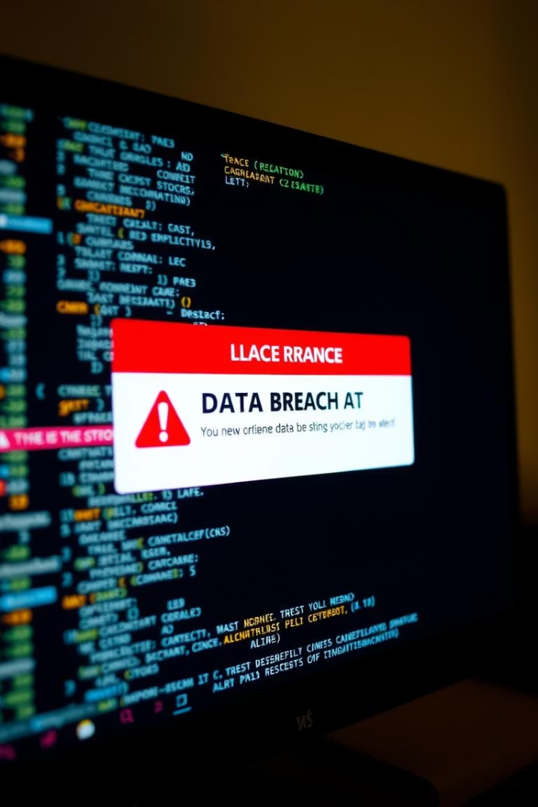
The Risks of Unchecked Prompt Injection
Data Breaches
Unauthorized access to sensitive information.
Reputation Damage
Generation of harmful or offensive content.
Financial Loss
Manipulation of transactions and systems.
Legal Liabilities
Failing compliance and misuse of personal data.

Slide 4
Current Detection Methods: An Overview
Signature-Based Detection
Anomaly Detection
Sandboxing
Limitations
Spotting unusual input or output behavior.
Isolating LLM execution to limit harm.
High false positives, evolving attack strategies.
Known attack patterns identification.

Slide 5
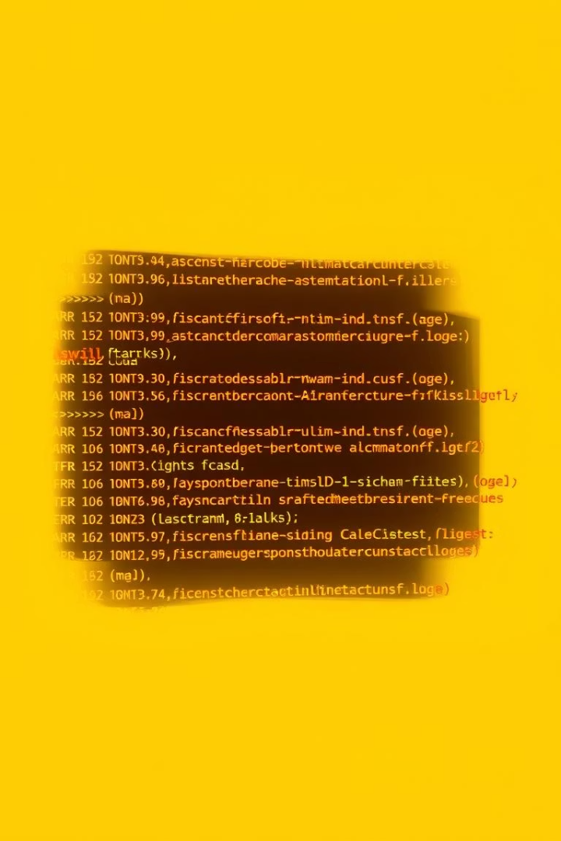
Signature-Based Detection
1
How it Works
Uses predefined rulesets to identify threats.
2
Strengths
Fast and easy to implement.
3
Weaknesses
Bypassed easily by new injection techniques.
4
Data Insight
65% bypass rate in recent tests (DEF CON AI Village, 2023).

Slide 6
Anomaly Detection
How it Works
Strengths
Weaknesses
Monitors deviations from normal LLM behavior.
Detects unknown or novel attacks.
Needs extensive training data; false positives at 40%.

Slide 7




Ethical Considerations: Bias and Fairness
Bias Risks
Diverse Data
Example
Detection tools may unfairly affect user groups.
Essential for fair, unbiased testing.
Language biases impact non-English prompt detection.

Slide 8

Ethical Considerations: Transparency & Explainability
User Rights
System Transparency
Opaque Systems
Clear rationale needed for blocked prompts.
Builds trust, reduces user frustration.
Cause confusion with vague messages like "try again."

Slide 9
Best Practices for Ethical Detection
Multi-layered Defenses
Use combined approaches for better security.
Continuous Updates
Revise detection rules and models regularly.
Transparency Priority
Explain actions to maintain user trust.
Collaborative Approach
Encourage teamwork between researchers and developers.
Reporting Systems
Clear channels for vulnerability disclosures.

Slide 10




The Future of LLM Security: A Shared Responsibility
Continuous Vigilance
1
Ongoing monitoring and adaptation are critical.
Ethical Development
2
Ethics must guide all AI advancement.
Collaboration
3
Partnerships strengthen security against threats.
Legal Compliance
4
Upcoming fines up to 4% of turnover (Gartner, 2025).

